Slide 1

VALLURUPALLI NAGESWARA RAO VIGNANA JYOTHI INSTITUTE OF ENGINEERING AND TECHNOLOGY
Department of Computer Science and Engineering
Ensemble Learning
Bagging & Boosting
MACHINE LEARNING
Dr. Kriti Ohri
Assistant Professor
Department of Computer Science and Engineering

Slide 2
Ensemble of classifiers
Bagging & Boosting
Ensemble methods

Slide 3
What are ensemble methods?
Ensemble learning is a machine learning paradigm where multiple models (often called “weak learners”) are trained to solve the same problem and combined to get better results. The main hypothesis is that when weak models are correctly combined we can obtain more accurate and/or robust models.
What Is Ensemble In Machine Learning?
Ensemble learning is a method that is used to enhance the performance of Machine Learning model by combining several learners. When compared to a single model, this type of learning builds models with improved efficiency and accuracy. This is exactly why ensemble methods are used to win market leading competitions such as the Netflix recommendation competition, Kaggle competitions and so on.

Slide 4
Single weak learner
In machine learning, no matter if we are facing a classification or a regression problem, the choice of the model is extremely important to have any chance to obtain good results. This choice can depend on many variables of the problem: quantity of data, dimensionality of the space, distribution hypothesis…
A low bias and a low variance, although they most often vary in opposite directions, are the two most fundamental features expected for a model. Indeed, to be able to “solve” a problem, we want our model to have enough degrees of freedom to resolve the underlying complexity of the data we are working with, but we also want it to have not too much degrees of freedom to avoid high variance and be more robust. This is the well known bias-variance tradeoff.

Slide 5
In ensemble learning theory, we call weak learners (or base models) models that can be used as building blocks for designing more complex models by combining several of them. Most of the time, these basics models perform not so well by themselves either because they have a high bias (low degree of freedom models, for example) or because they have too much variance to be robust (high degree of freedom models, for example). Then, the idea of ensemble methods is to try reducing bias and/or variance of such weak learners by combining several of them together in order to create a strong learner (or ensemble model) that achieves better performances.

Slide 6
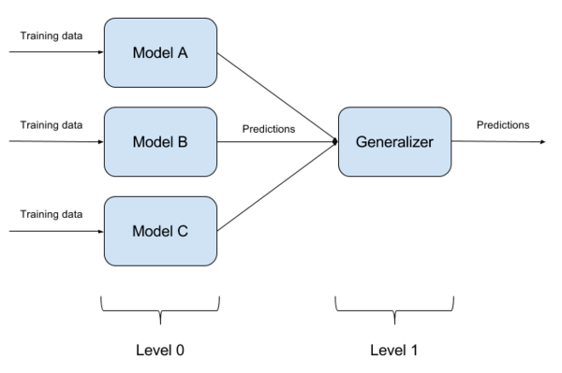
Ensemble learning

Slide 7
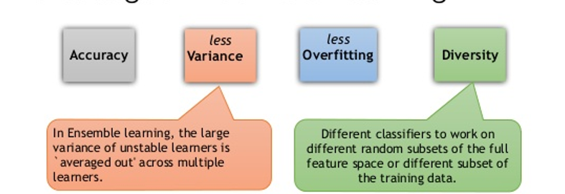
Advantages of ensemble learning

Slide 8
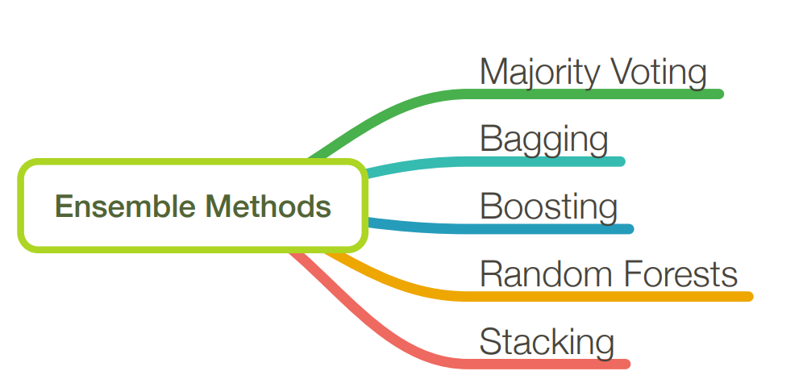

Slide 9
Majority Voting
9

Slide 10
Unanimity
Majority Plurality
10

Slide 11








Majority Vote Classifier
Training set
New data
Classification models
h₁
h₂
. . .
h_{n}
Predictions
y₁
. . .
y_{n}
y₂
Voting
Final prediction
y_{f}
y_{f}̂ = mode{h₁(x), h₂(x), . . . h_{n}(x)}
where h_{i}(x) = y_{i}
11

Slide 12
Why Majority Vote?
assume n independent classifiers with a base error rate ϵ
here, independent means that the errors are uncorrelated
assume a binary classification task
assume the error rate is better than random guessing (i.e., lower than 0.5 for binary classification)
∀ϵ_{i} ∈ {ϵ₁, ϵ₂, . . . , ϵ_{n}}, ϵ_{i} < 0.5

Slide 13
Why Majority Vote?
assume n independent classifiers with a base error rate ϵ
here, independent means that the errors are uncorrelated
assume a binary classification task
assume the error rate is better than random guessing (i.e., lower than 0.5 for binary classification)
∀ϵ_{i} ∈ {ϵ₁, ϵ₂, . . . , ϵ_{n}}, ϵ_{i} < 0.5
The probability that we make a wrong prediction via the ensemble if k classifiers predict the same class label
P(k) = ^{n} ϵ^{k}(1 − ϵ)^{n−k}
k > ⌈n/2⌉
(k)

Slide 14
Ensemble Learning techniques
Bagging
(Bootstrap Aggregating)
Eg. Random forest
Boosting
Eg. Adaboost

Slide 15
Bagging relies on a concept similar to majority voting but uses the same learning algorithm (typically a decision tree algorithm) to fit models on different subsets of the training data (bootstrap samples).
Bagging can improve the accuracy of unstable models that tend to overfit.

Slide 16
Bagging (Bootstrap Aggregating)
Bagging, that often considers homogeneous weak learners, learns them independently from each other in parallel and combines them following some kind of deterministic averaging process.
Bagging, also known as Bootstrap Aggregating, is used to improve accuracy and make the model more generalize by reducing the variance, i.e., avoiding overfitting. In this, we take multiple subsets of the training dataset. For each subset, we take a model with the same learning algorithms like Decision tree, Logistic regression, etc., to predict the output for the same set of test data. Once we predict each model, we use a model averaging technique to get the final prediction output. One of the famous techniques used in Bagging is Random Forest. In the Random forest, we use multiple decision trees.

Slide 17
A Bagging classifier is an ensemble meta-estimator that fits base classifiers each on random subsets of the original dataset and then aggregate their individual predictions (either by voting or by averaging) to form a final prediction. Such a meta-estimator can typically be used as a way to reduce the variance of a black-box estimator (e.g., a decision tree), by introducing randomization into its construction procedure and then making an ensemble out of it.

Slide 18
Each base classifier is trained in parallel with a training set which is generated by randomly drawing, with replacement, N examples(or data) from the original training dataset – where N is the size of the original training set. Training set for each of the base classifiers is independent of each other. Many of the original data may be repeated in the resulting training set while others may be left out.

Slide 19
Bagging reduces overfitting (variance) by averaging or voting, however, this leads to an increase in bias, which is compensated by the reduction in variance though.

Slide 20
How Bagging works on training dataset ?
How bagging works on an imaginary training dataset is shown below. Since Bagging resamples the original training dataset with replacement, some instance(or data) may be present multiple times while others are left out.
Original training dataset: 1, 2, 3, 4, 5, 6, 7, 8, 9, 10
Resampled training set 1: 2, 3, 3, 5, 6, 1, 8, 10, 9, 1
Resampled training set 2: 1, 1, 5, 6, 3, 8, 9, 10, 2, 7
Resampled training set 3: 1, 5, 8, 9, 2, 10, 9, 7, 5, 4

Slide 21
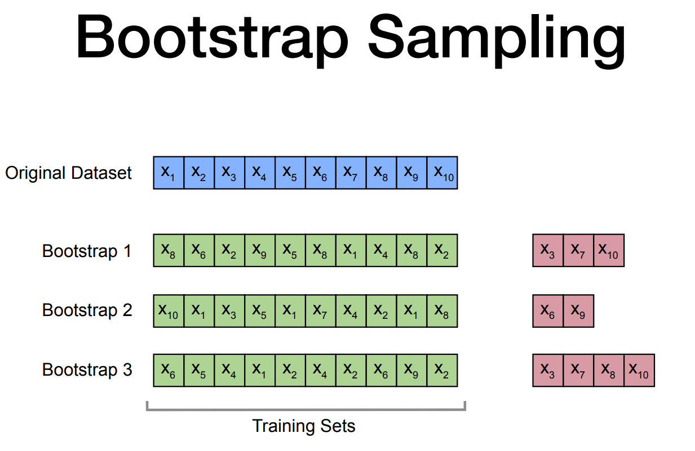
Out-of-bag samples
Notes:
Random sampling with replacement , with uniform distribution

Slide 22
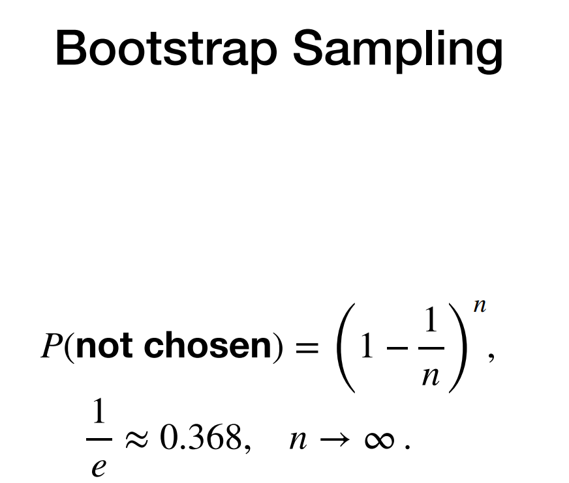

Slide 23
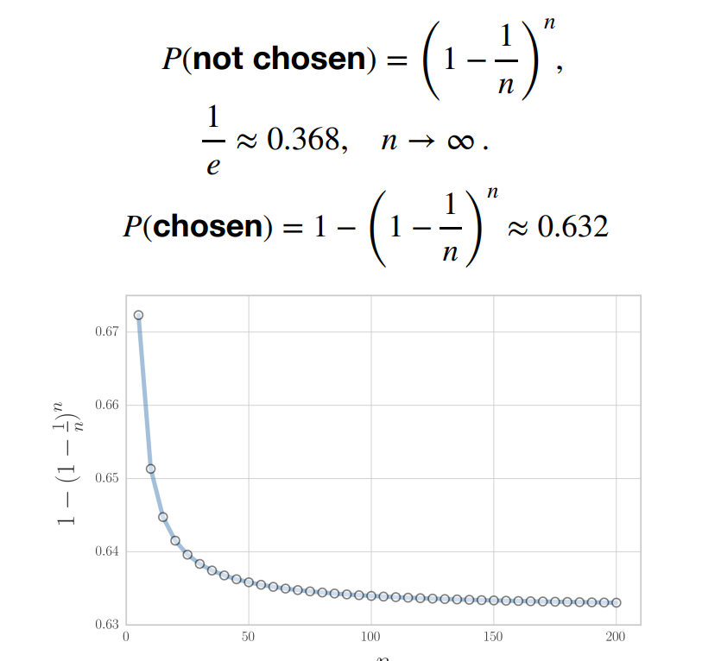

Slide 24
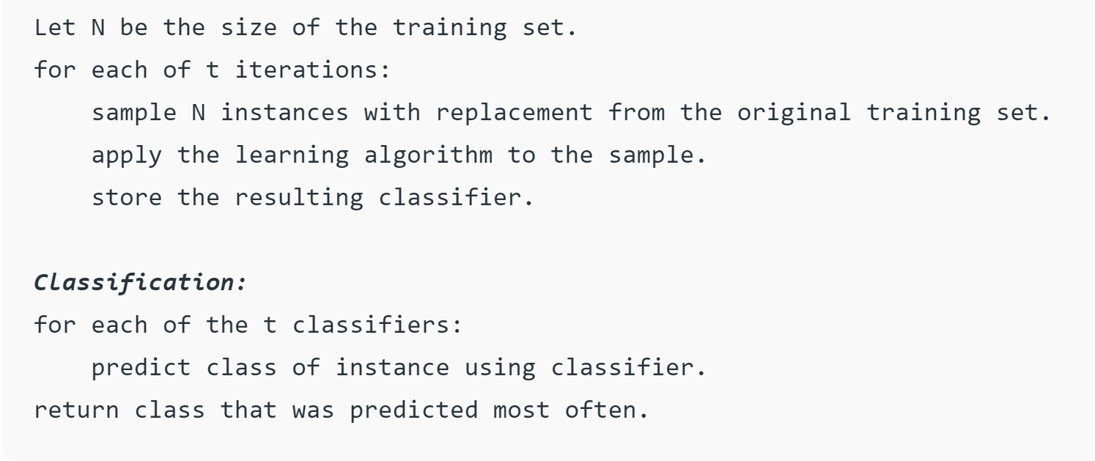
Algorithm for the Bagging classifier:

Slide 25
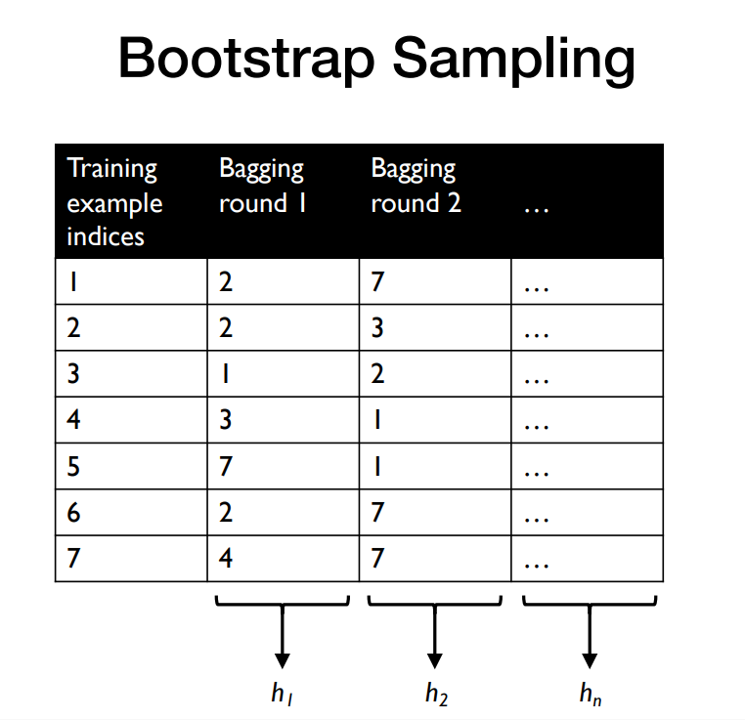

Slide 26
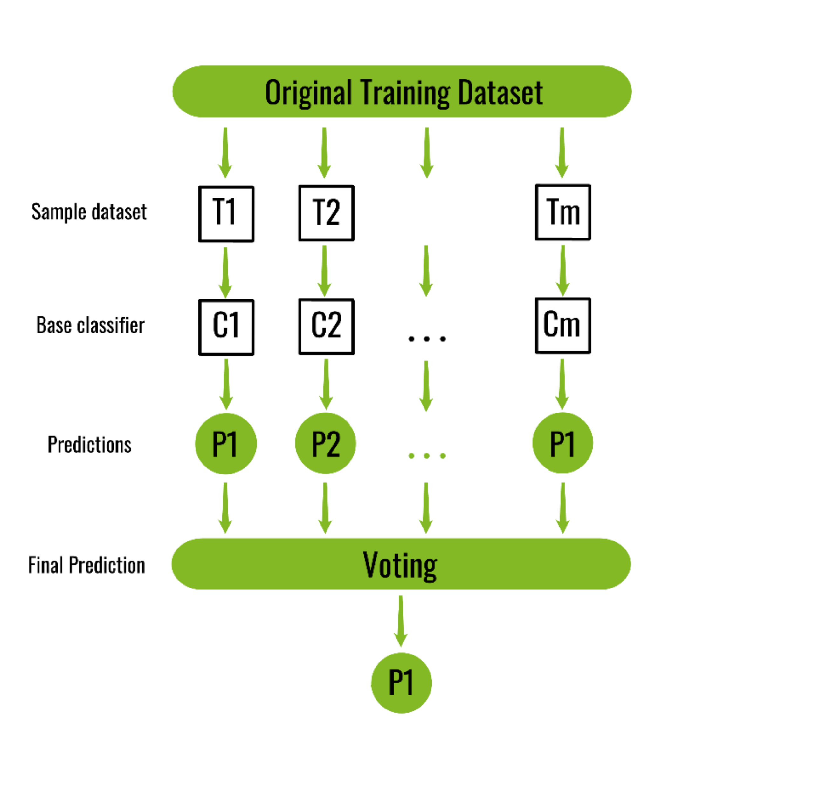
Bagging
Bootstrap sampling means drawing random samples from our training set with replacement
Called bootstrap samples
Weak learners or
majority rule
bagging classifier would have a lower variance (less overfitting) than an individual models.
Parallel ensemble methods: In these methods, the base learners are generated in parallel simultaneously. For example, when deciding the movie you want to watch, you may ask multiple friends for suggestions and probably watch the movie which got the highest votes.
Notes:
Bagging rounds. Multi processing parallel

Slide 27
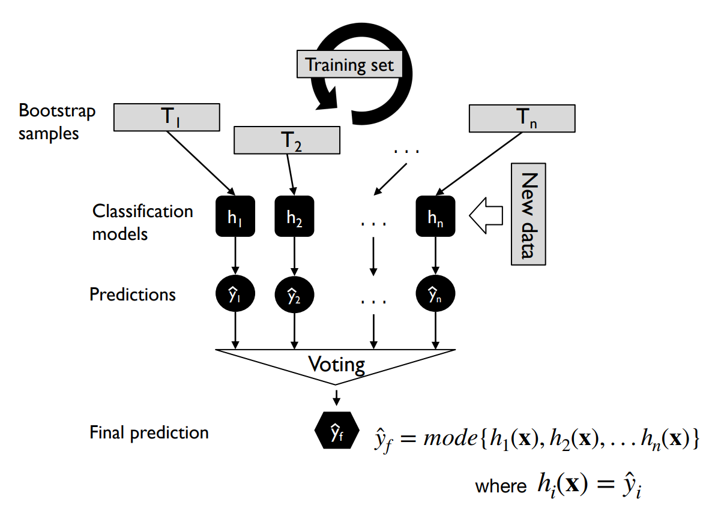
Bagging

Slide 28
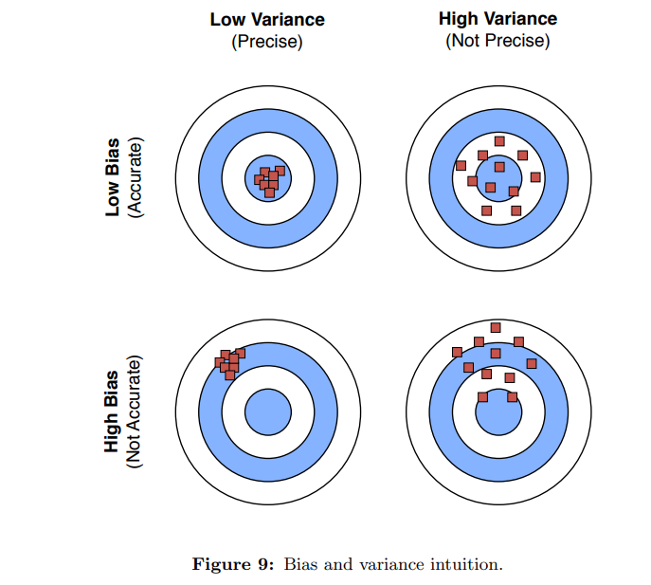

Slide 29
One can say that individual, unpruned decision tree “have high variance” (in this context, the individual decision trees “tend to overfit”); a bagging model has a lower variance than the individual trees and is less prone to overfitting – again, bias and variance decomposition will be discussed in more detail next lecture.

Slide 30
Bagging
Increase accuracy of models.
Decrease the degree of overfitting
Increase generalizability of the model
Decrease the variance of the model
Based on Majority vote

Slide 31
Boosting
An Ensemble method

Slide 32
Boosting
Boosting is primarily used to reduce the bias and variance in a supervised learning technique. It refers to the family of an algorithm that converts weak learners (base learner) to strong learners. The wea
k learner is the classifiers that are correct only up to a small extent with the actual classification, while the strong learners are the classifiers that are well correlated with the actual classification. Few famous techniques of Boosting are AdaBoost, GRADIENT BOOSTING, XgBOOST (Extreme Gradient Boosting). So now we know what bagging and boosting are and what are their roles in Machine Learning.

Slide 33
Types of boosting techniques
AdaBoost (Adaptive Boosting)
Gradient Boosting
3. XGBoost: eXtreme Gradient Boosting

Slide 34
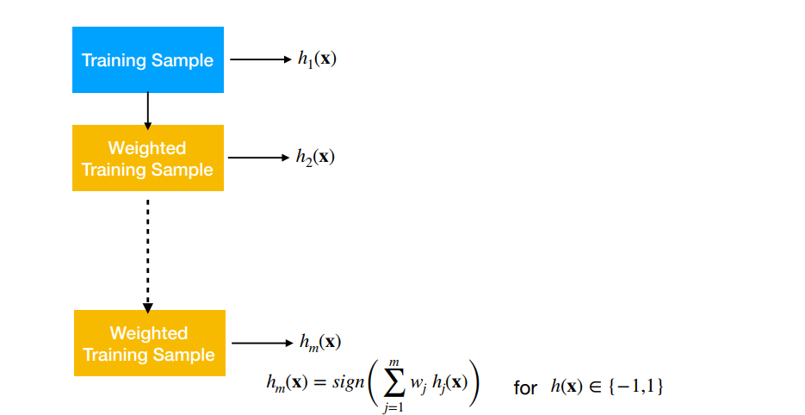
Boosting

Slide 35
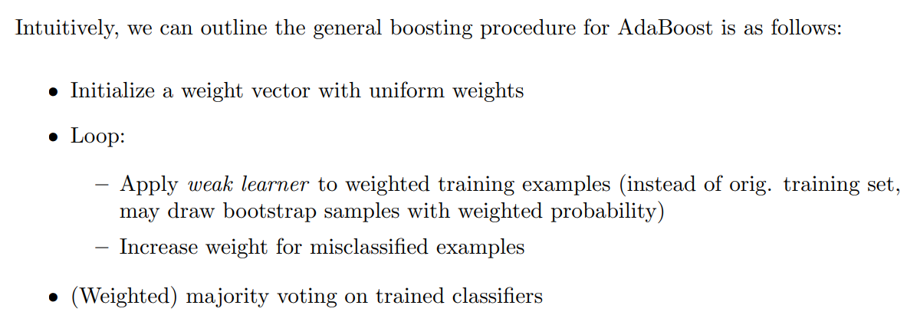

Slide 36
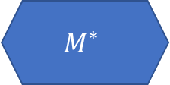
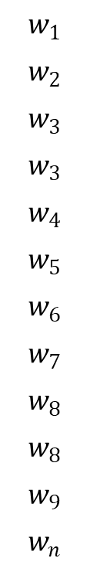
Boosting
Sequential ensemble methods: In this technique, different learners learn sequentially with early learners fitting simple models to the data. Then the data is analyzed for errors. The goal is to solve for net error from the prior model. The overall performance can be boosted by weighing previously mislabeled examples with higher weight.
1
2
3
4
5
6
7
8
9
.
.
n
$$w_{1}$$
$$w_{2}$$
$$w_{3}$$
$$w_{3}$$
$$w_{4}$$
$$w_{5}$$
$$w_{6}$$
$$w_{7}$$
$$w_{8}$$
$$w_{8}$$
$$w_{9}$$
$$w_{n}$$
Dataset 1
Dataset 2
Dataset 3
1
3
6
7
9 :
4
6
7
3
7 :
:
Weak learners, base models
Model 1
Model 2
Model 3
New input instance will be given to all the models
1
1
0
$$M^{∗}$$
Strong learner
Original dataset
1

Slide 37
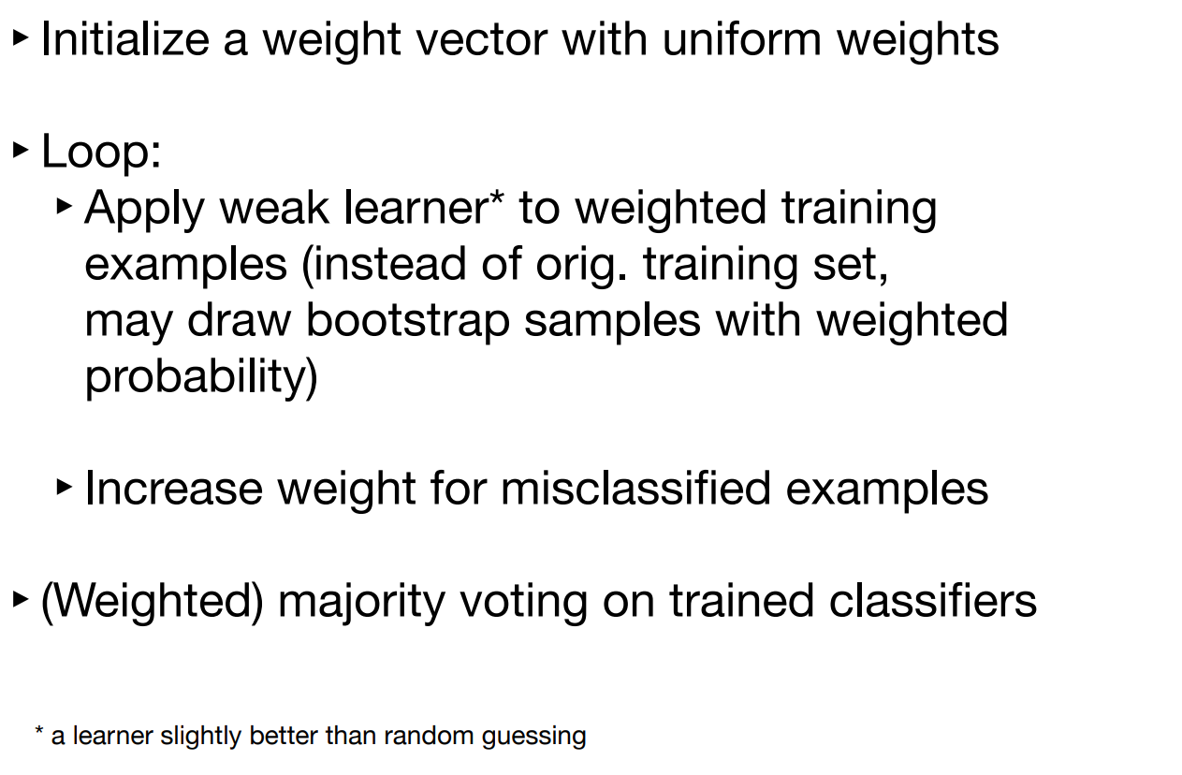
Boosting

Slide 38
Initially all the records have equal weights in the original dataset.
Each record is equally probably to be selected in the to form the dataset 1 on which the model will be trained.
Once model 1 is trained on subset of samples from the original dataset, predictions are done on original dataset input features.
The weight of those records is increased which are not able to be classified by model 1 correctly.
Hence the probability of those records which are not classified correctly by model 1 have more chances to be selected in the dataset2.

Slide 39
Adaboost: E.g. algorithm for boosting
In contrast to bagging, you use very simple classifiers as base classifiers, so-called “weak learners.”
Picture these weak learners as “decision tree stumps” – decision trees with only 1 splitting rule.
Most popular example of boosting, AdaBoost. Here, we start with one decision tree stump (1) and “focus” on the samples it got wrong. In the next round, we train another decision tree stump that attempts to get these samples right (2); we achieve this by putting a larger weight on these training samples. Again, this 2nd classifier will likely get some other samples wrong, so you’d re-adjust the weights …

Slide 40
In a nutshell, we can summarize “Adaboost” as “adaptive” or “incremental” learning from mistakes. Eventually, we will come up with a model that has a lower bias than an individual decision tree (thus, it is less likely to underfit the training data).

Slide 41
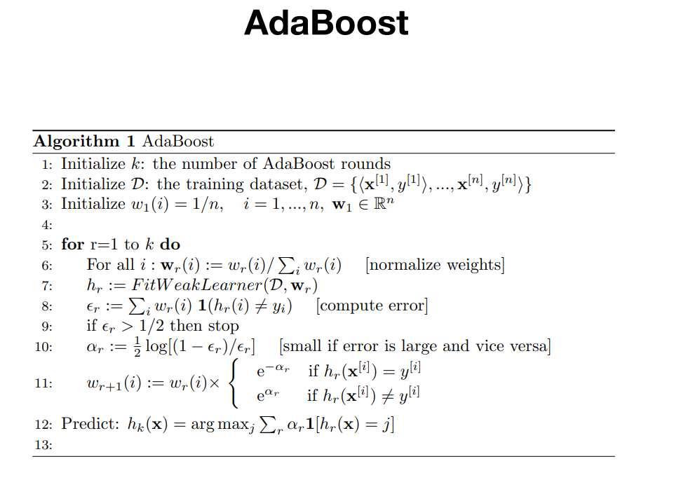

Slide 42
Adaboost (Adaptive Boosting) example of Boosting algorithm
The general idea behind boosting methods is to train predictors sequentially, each trying to correct its predecessor. The most commonly used boosting algorithms is AdaBoost.
Stump
Stump
Stump
tree stumps” – decision trees with only 1 splitting rule.

Slide 43
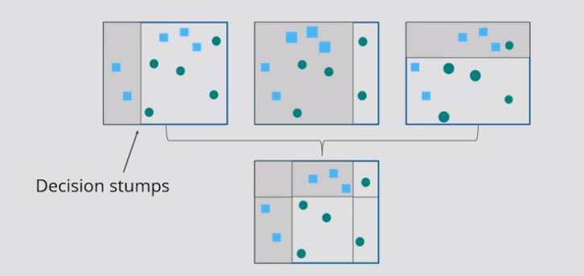

Slide 44
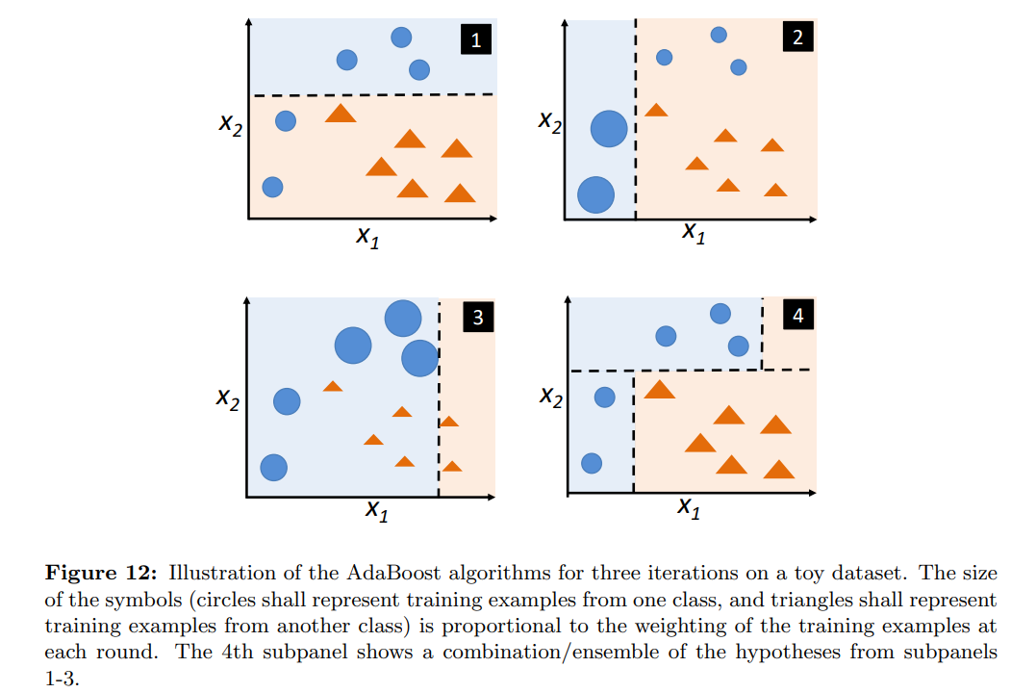

Slide 45
In contrast to bagging, you use very simple classifiers as base classifiers, so-called “weak learners.” Picture these weak learners as “decision tree stumps” – decision trees with only 1 splitting rule. Below, we will refer to the probably most popular example of boosting, AdaBoost. Here, we start with one decision tree stump (1) and “focus” on the samples it got wrong. In the next round, we train another decision tree stump that attempts to get these samples right (2); we achieve this by putting a larger weight on these training samples. Again, this 2nd classifier will likely get some other samples wrong, so you’d re-adjust the weights …

Slide 46
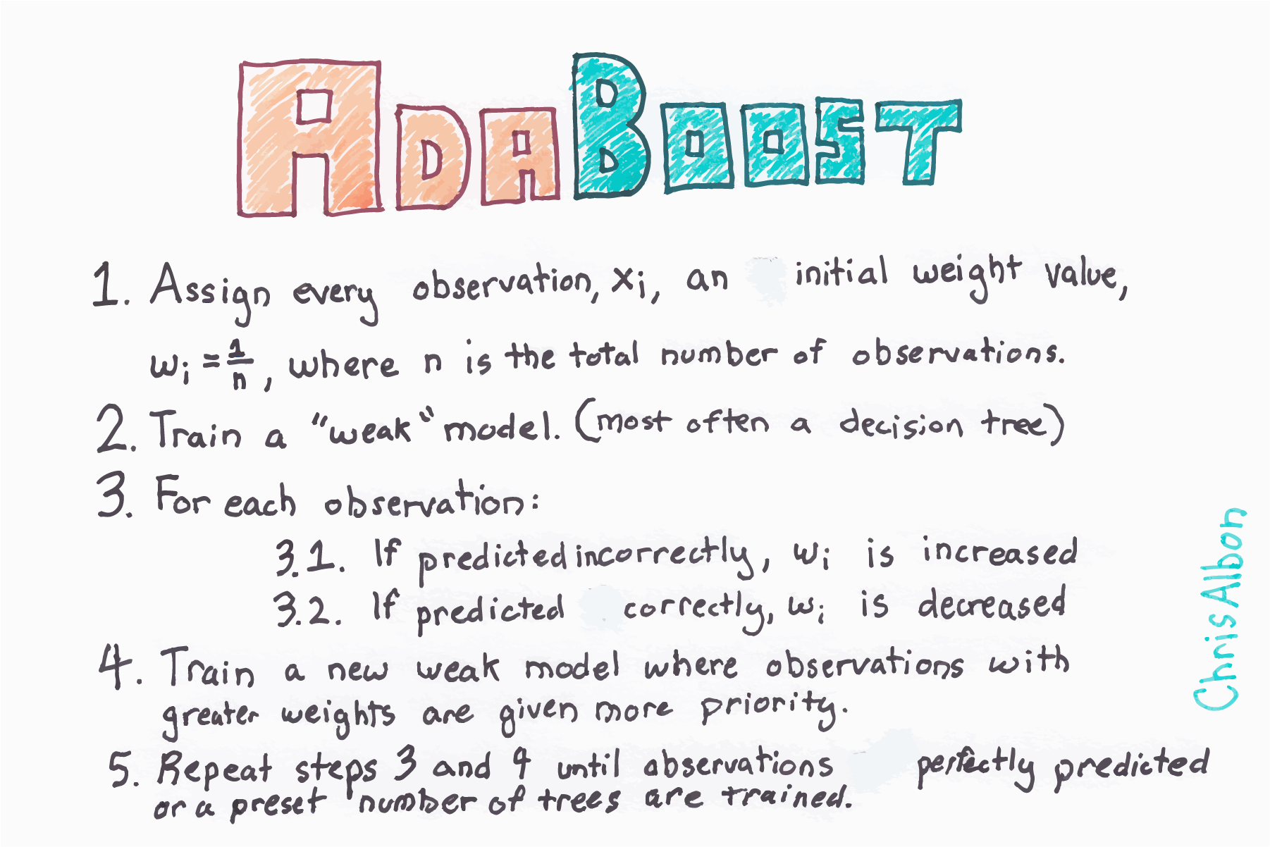

Slide 47
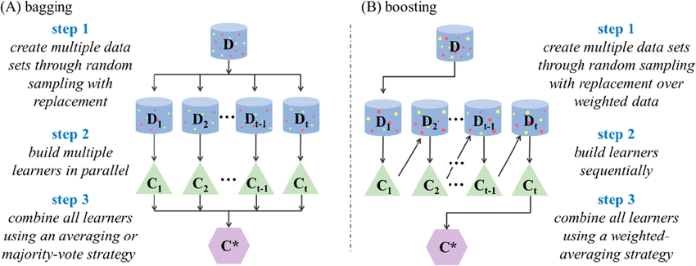
Bagging and boosting in steps

Slide 48
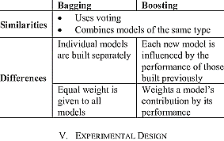

Slide 49
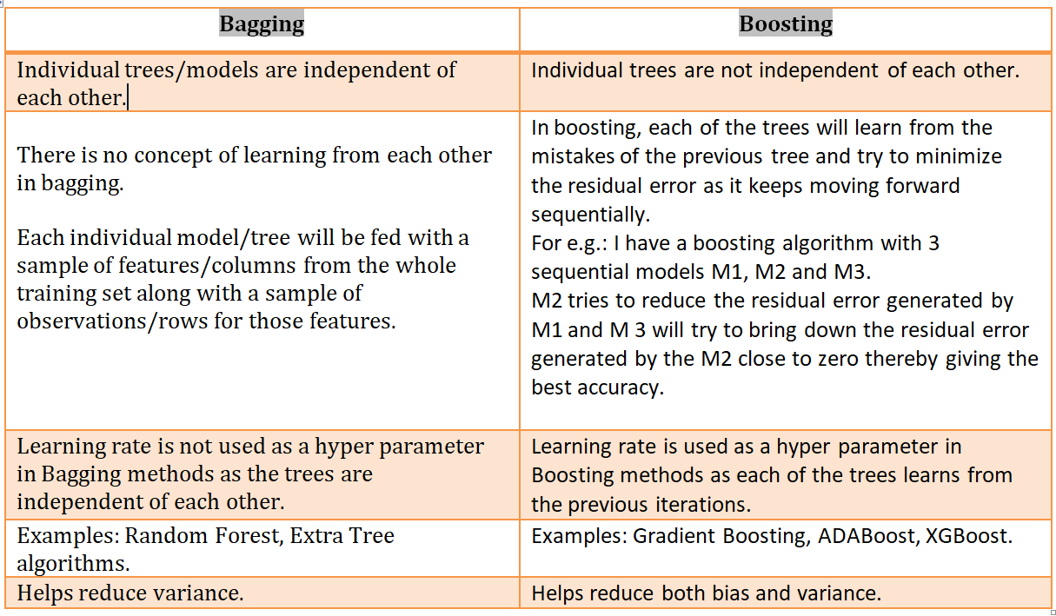

Slide 50
Applications of bagging and boosting
There are multiple areas where Bagging and Boosting technique is used to boost the accuracy.
Banking: Loan defaulter prediction, fraud transaction
Credit risks
Kaggle competitions
Fraud detection
Recommender system for Netflix
Malware
Wildlife conservations and so on.

Slide 51
Advantages of Boosting
It is one of the most successful techniques in solving the two-class classification problems.
It is good at handling the missing data.
Disadvantages of Boosting
Boosting is hard to implement in real-time due to the increased complexity of the algorithm.
The high flexibility of these techniques results in multiple numbers parameters that directly affect the behaviour of the model.

Slide 52
References
https://www.youtube.com/watch?v=KIOeZ5cFZ50
https://www.youtube.com/watch?v=NLRO1-jp5F8

